Slide 1
Wiegmann Quote Process Review

Slide 2
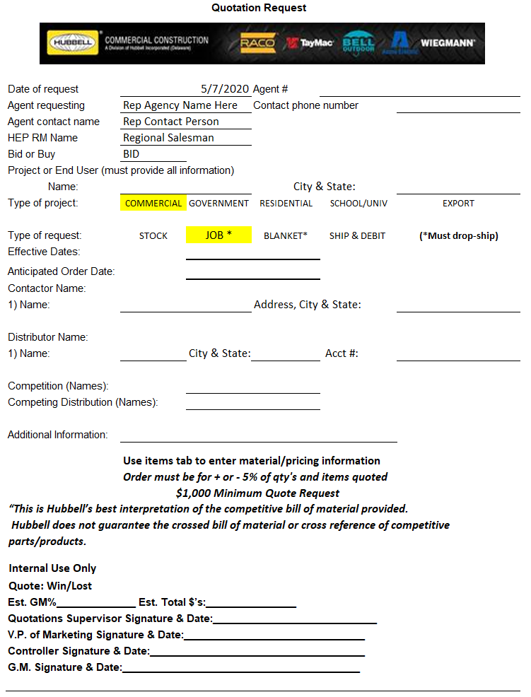
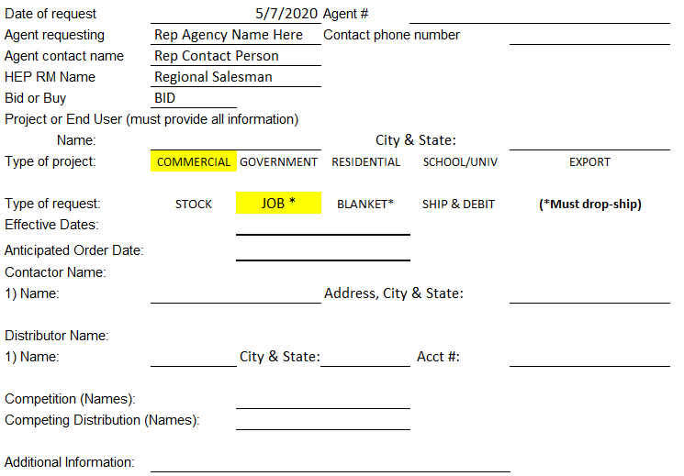
Stock Quotation Request Form

Slide 3
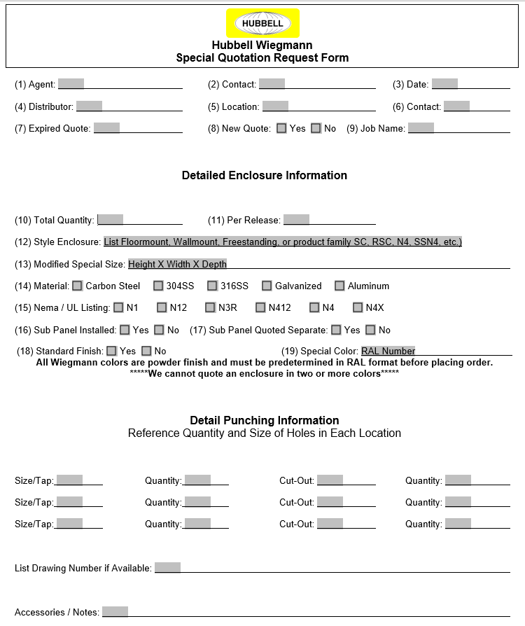
Special Quotation Request Form

Slide 4
Where to send Quotation Request
Stock Quotation Request Forms:
WiegmannQuotations@Hubbell.com
Special Quotation Request Forms:
tblow@hep.hubbell.com
mirvin@hep.hubbell.com
dharms@hubbell.com

Slide 5
Drawing Requirements
Stock Product Models (Drawings) available on Wiegmann website
We convert Customer-provided drawings for modified enclosures to a Wiegmann drawing for customer sign-off (basic construction, bend radius)
Customer to approve drawing before lead time starts on first time specials
Repeat Specials do not require sign-off unless changes were made.

Slide 6
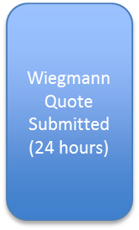
Basic Quotation Process Flow
Special RFQ submitted
on Special Quote form
Order receive & HFWS part number created (lead time starts unless drawing approval is needed)
Drawing created and sent back for approval (if needed)
Special enclosure built and shipped (per quoted lead time)
Stock RFQ submitted on stock quotation
form
Proposed Pricing provided normally via email
Proposed pricing accepted and Formal Quote entered in SAP
Rep Agency Enters stock order via EDI

